Slide 1
Predicting Bike Sharing Demand in Cities
Modupeola Fagbenro, Crystal Kao, Guruksha Gurnani, Shanun Randev
DATS6101

Slide 2
Background
In large cities where traffic is high and distance between destinations is short, bike sharing has become an alternative form of transportation
Bike sharing is being able to rent a bike at set locations with no need to return them to the original bike rack as there are multiple locations across a city that you can return them to
Data Source: https://www.kaggle.com/competitions/bike-sharing-demand/data
SMART Questions
Which variables are useful for predicting the number of bikes used in an hour?
How does temperature affect the number of bikes in use?
When do casual bikers increase the most?
Can we estimate when it is a holiday depending on other bikeshare factors?

Slide 3
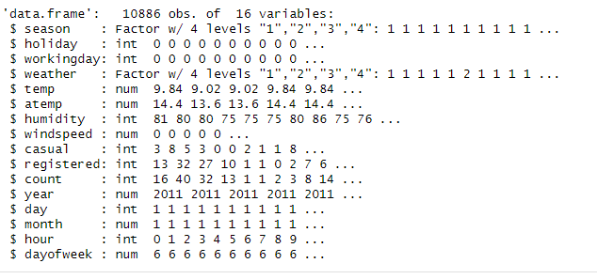
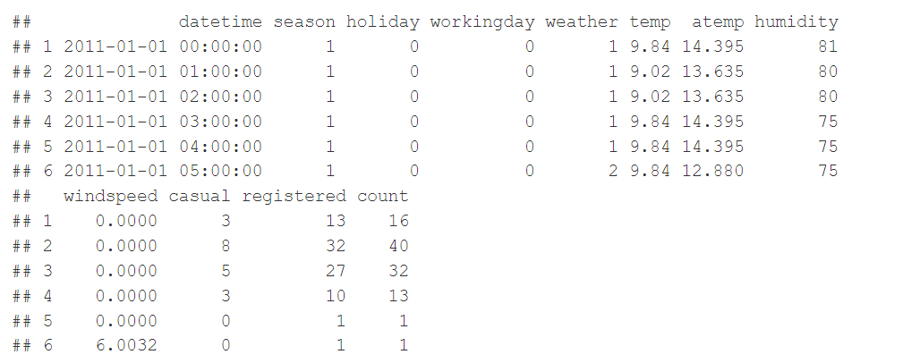
Data Description
Structure of dataset
Glimpse of what the dataset consists of

Slide 4
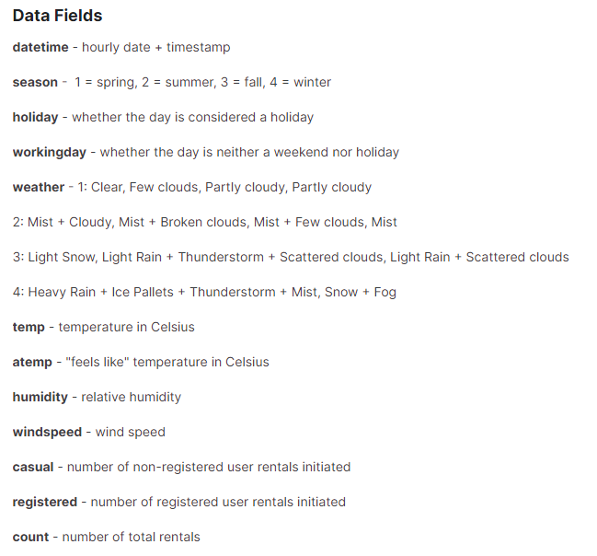
Variable Definitions

Slide 5
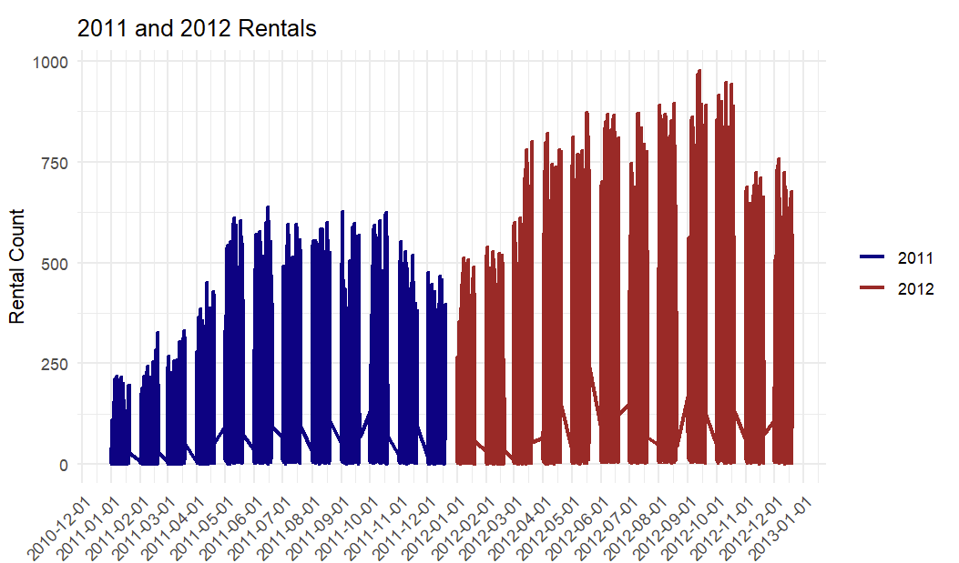
All Rental Data by Month for 2011-2012
There were more bike rentals in 2012 compared to 2011, and for both years, there were the most bike rentals during the summer and fall months

Slide 6
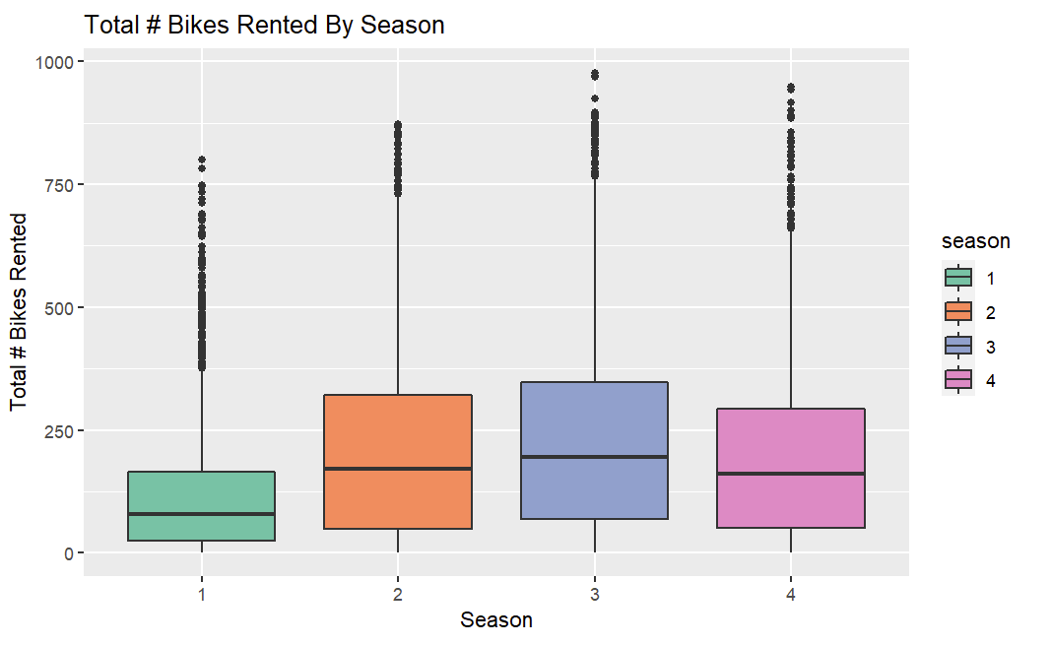
Bike Rentals by Seasons
Spring
Summer
Fall
Winter
When comparing by season, the graphs also shows the most bike rentals were during the summer and fall months

Slide 7
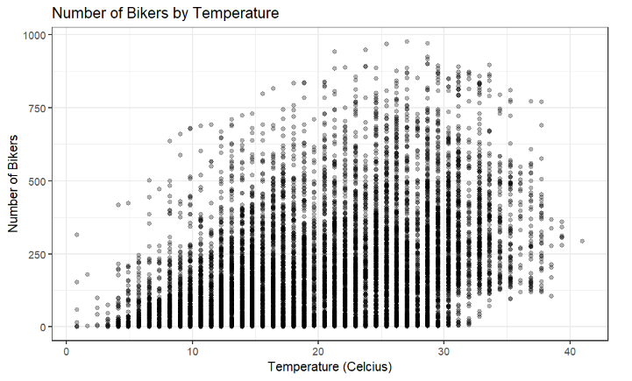
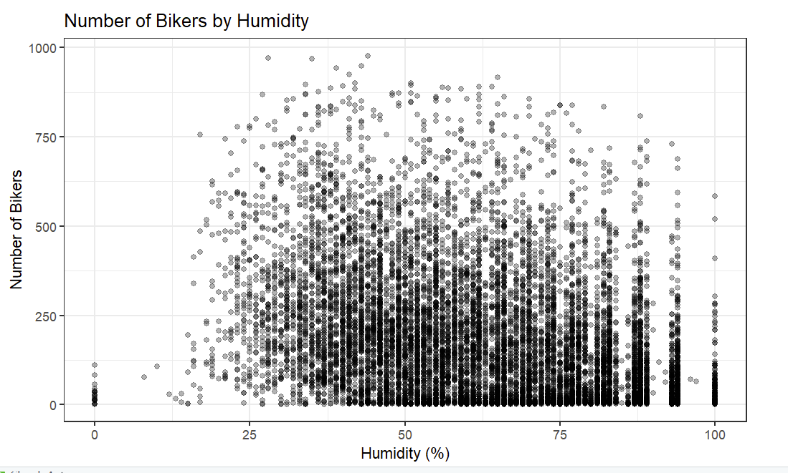
Bike Rentals by Temperature and Humidity
SMART Question: How does temperature affect the number of bikes in use?
The number of bike rentals increased when temperatures increased but dropped off once temperatures started reaching the high 30s (Celsius). The number of bike rentals also increased with increased humidity.

Slide 8
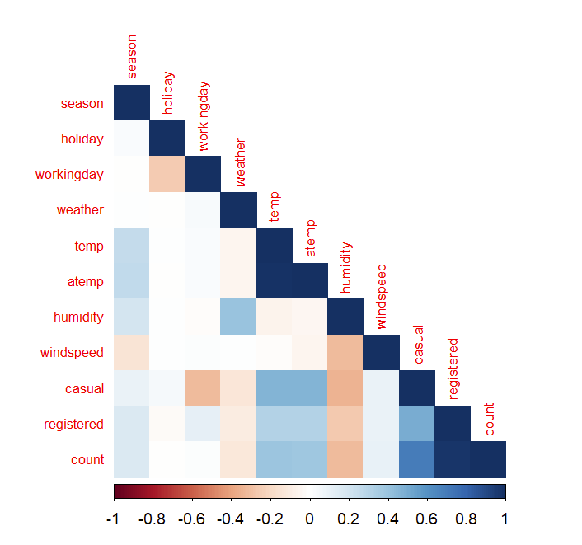
Correlation of Continuous Variables
From the heatmap of correlations shown to the right, it can be concluded that:
temperature (temp) and feeling temperature (atemp) have high positive correlation
count and registered also have high positive correlation (which makes sense because registered and casual add up to count)

Slide 9
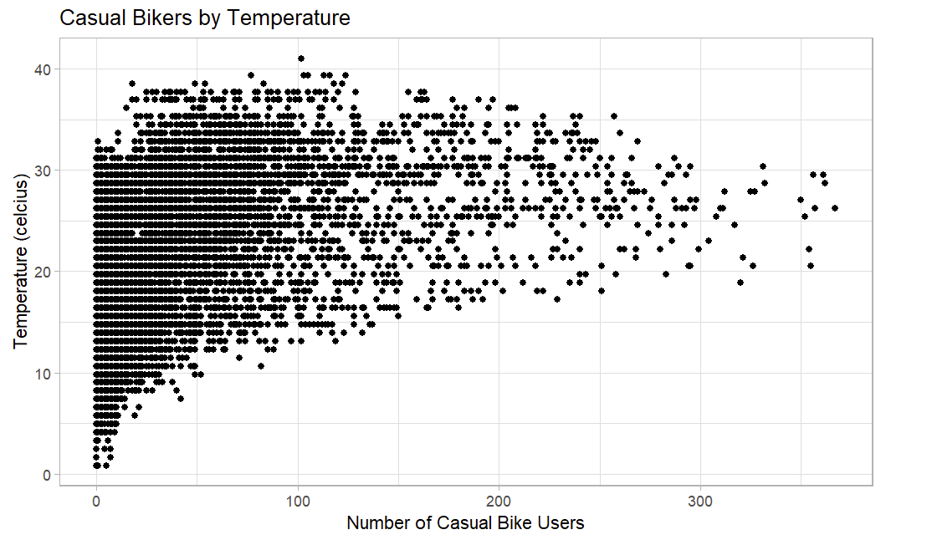
SMART Question: When do casual bikers increase the most?
The number of casual bike rentals increased when temperatures increased but dropped off once temperatures started reaching the high 30s (Celsius). Majority of them rented bikes on days where temperature was between 20-30 degrees.

Slide 10
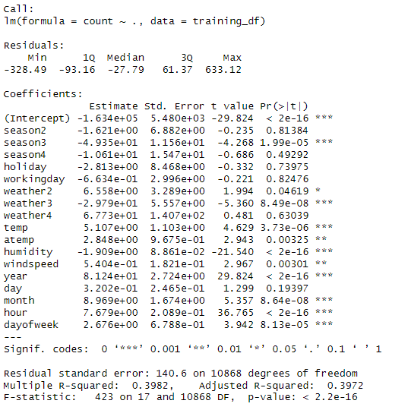
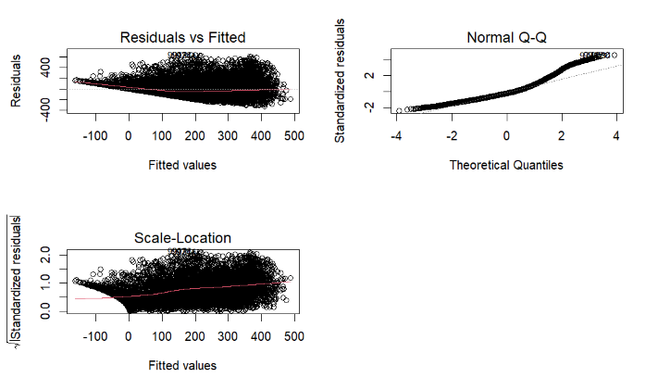
Linear Model (Model 1)
To answer the bigger question of how to predict the number of rentals in a city and the more specific SMART Question: Which variables are useful for predicting the number of bikes used in an hour, a linear model was used including all the variables available
Excludes casual and registered because they add up to the count
Reformatted datetime into year, day, month, and hour
Made weather and season into factors
However, based on the results of the residuals vs fitted plot, the variance of residuals increased as the values increased. A log transformation was considered to see if there was a model with more constant variance.

Slide 11
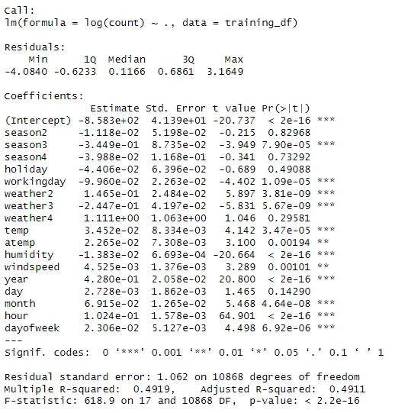
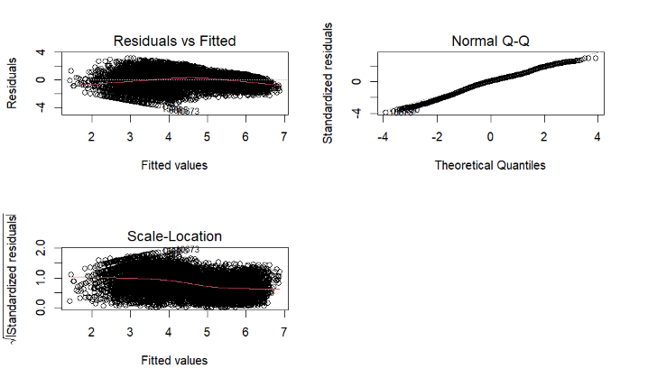
Log Transformation (Model 2)
After running the log transformation, the residuals vs fitted plot no longer increased as the values increased. The qq-plot also shows that normality is a reasonable assumption.

Slide 12
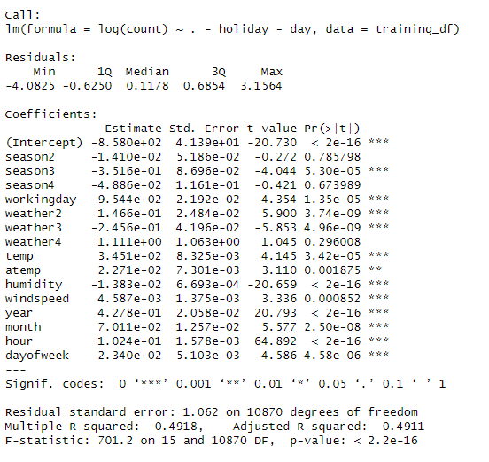
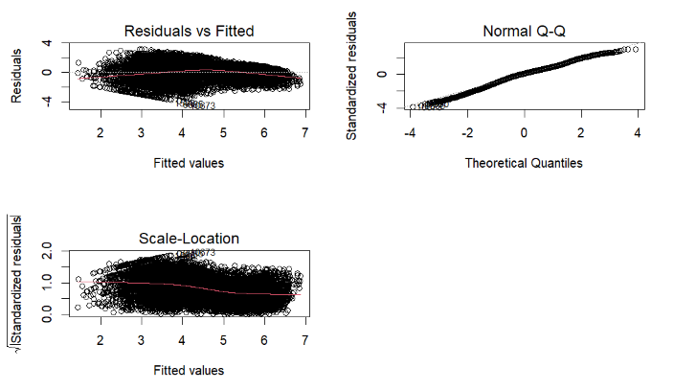
Model Selection (Model 3)
To create a parsimonious model and remove unnecessary variables, ‘holiday’ and ‘day’ were taken out of this model based on the p-values of the previous log model (model 2).
The qq-plot again shows that normality is a reasonable assumption.
Notes:
Parsimonious= as few variables as possible

Slide 13
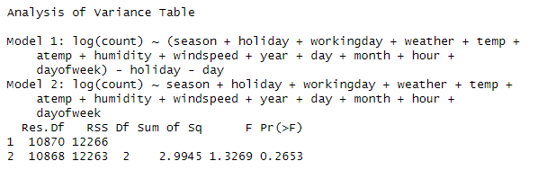
ANOVA
Model 3 was then compared to Model 2.
Null Hypothesis: Model 3 is a reasonable fit
Alternative Hypothesis: Model 2 is a reasonable fit
The p-value is greater than 0.05, so we do not reject the null hypothesis, which means Model 3 is adequate to model the rentals. There's no evidence that including ‘holiday’ and ‘day’ improves the model's fit.
3

Slide 14
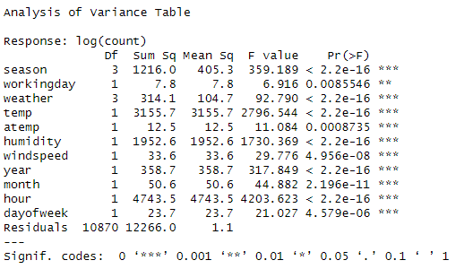
ANOVA on Final Model
The ANOVA run shows that all variables in Model 3 are statistically significant due to the p-values.
This means that removing any more variables would reduce model fit.
In conclusion, this would be a reasonable model for predicting number of rentals.

Slide 15
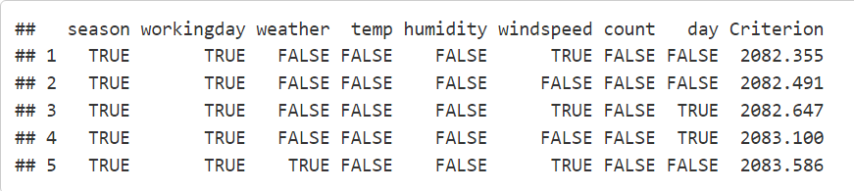
Logit Model
To answer the SMART question: Can we estimate when it is a holiday depending on other bikeshare factors, a logit model was used due to holiday being a categorical variable.
‘year’, ‘month’, ‘hour’, and ‘dayofweek’ were excluded logically based on how holidays work
‘atemp’ was excluded since ‘temp’ is already in the dataset
Made workingday into a factor
Based on running bestglm, the best model was found to only be influenced by `season`, `windspeed` and `workingday`, with an AIC of 2082.

Slide 16
Conclusion
SMART Questions
Which variables are useful for predicting the number of bikes used in an hour?
All variables other than ‘holiday’ and ‘day’ are useful for predicting the number of bikes used in an hour.
How does temperature affect the number of bikes in use?
The temperature graph show bikers increase with higher temperatures. The final model also shows a slight increase in the number of bikers when temperature increases.
When do casual bikers increase the most?
Again, the temperature graph showing casual bikers specifically shows that bikers increase with higher temperatures, with majority of them renting bikes on days where temperature is between 20-30 Celsius.
Can we estimate when it is a holiday depending on other bikeshare factors?
Yes, the best model for finding out if a day is a holiday is based on `season`, `windspeed` and `workingday`.

